Slide 1

Mutual Fund Analytics Platform
BLUESTOCK FINTECH
CAPSTONE PROJECT · DATA ANALYST INTERNSHIP
End-to-End Data Engineering, ETL Pipeline & Interactive Dashboard
40
Fund Schemes
87K+
Rows of Data
4.5 Yrs
NAV History
10
Datasets
Domain: Mutual Fund / Fintech · Data Source: AMFI India, mfapi.in, NSE/BSE · June 2026

Slide 2
Problem & Objective
SECTION 01
Fragmented AMFI data and complex risk metrics make data-driven fund selection hard. We build one unified analytics platform to solve it.
5 REAL PROBLEMS
THE OBJECTIVE
P1
Data fragmentation across TXT/PDF/HTML sources
Build a full-stack platform that ingests public AMFI data through an ETL pipeline, stores it in a relational database, and surfaces insight via an interactive dashboard.
P2
No easy risk-adjusted fund comparison
No benchmark / tracking-error visibility
Automated ETL pipeline from raw AMFI data
P3
Normalised 5-table star-schema database
P4
Investor behaviour is a demographic blind spot
Risk & performance metrics per scheme
Benchmark comparison vs Nifty 50 / 100
P5
Slow, static monthly PDF reporting
Executive interactive BI dashboard
Bluestock Fintech | Mutual Fund Analytics Platform
02

Slide 3
Data Sources & Datasets
SECTION 02
All data is publicly sourced — no proprietary or confidential data is used.
PUBLIC SOURCES
10
87K+
AMFI India
Datasets
Total Rows
NAV, AUM, Folio, SIP
mfapi.in
Historical NAV (JSON API)
mfdata.in
46K
32K
NAV + expense ratio
NSE India
NAV records
Investor txns
Benchmark index prices
BSE India
BSE SmallCap index
Key datasets: fund_master · nav_history · aum_by_fund_house · monthly_sip_inflows · scheme_performance · investor_transactions · portfolio_holdings · benchmark_indices
AMFI Monthly Notes
Industry SIP & flow data
Bluestock Fintech | Mutual Fund Analytics Platform
03

Slide 4
System Architecture & ETL Pipeline
SECTION 03
A classic Extract → Transform → Load → Analyse → Visualise pipeline.
EXTRACT
TRANSFORM
LOAD
ANALYSE
VISUALISE
01
02
03
04
05
Data Sources
▶
Data Processing
▶
Data Storage
▶
Analytics
▶
Dashboard
AMFI NAV/API, mfapi.in, NSE/BSE bhavcopy, CSV datasets
Pandas clean, forward-fill NAV, derived returns, normalise names
SQLite/PostgreSQL star schema, indexed on code + date
EDA notebooks, Sharpe/Sortino/Alpha/Beta, cohorts, geo heatmap
Power BI / Tableau, 4 pages, slicers, KPI cards, PDF export
STAR SCHEMA: 2 dimensions (dim_fund, dim_date) + 5 fact tables (nav, transactions, performance, portfolio, aum) — indexed for fast queries
Bluestock Fintech | Mutual Fund Analytics Platform
04

Slide 5
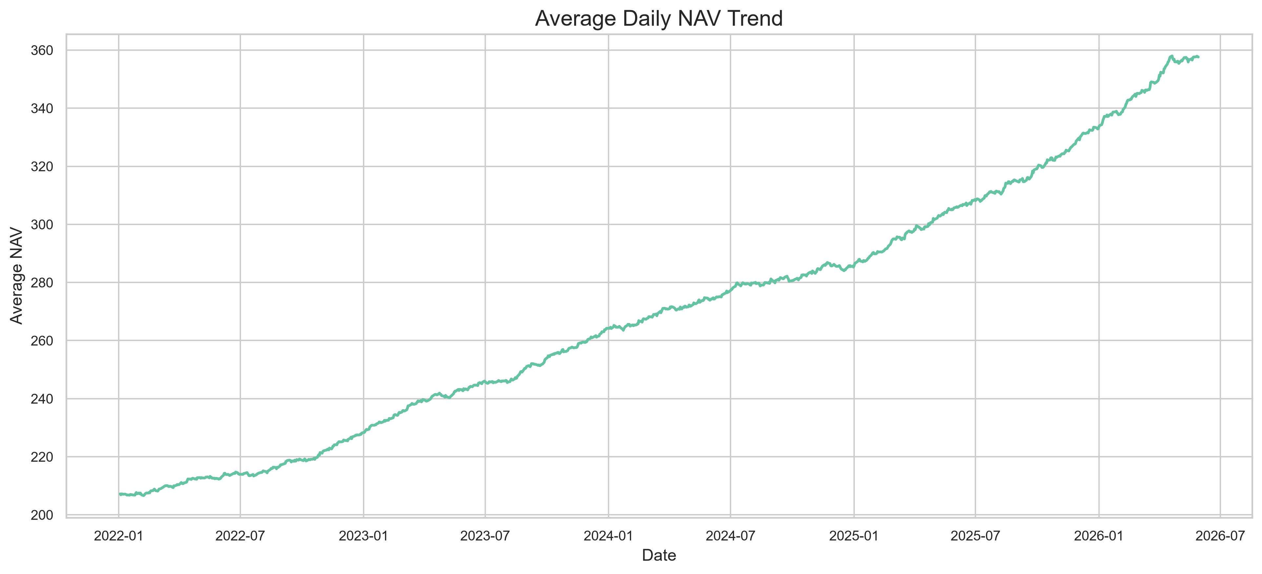
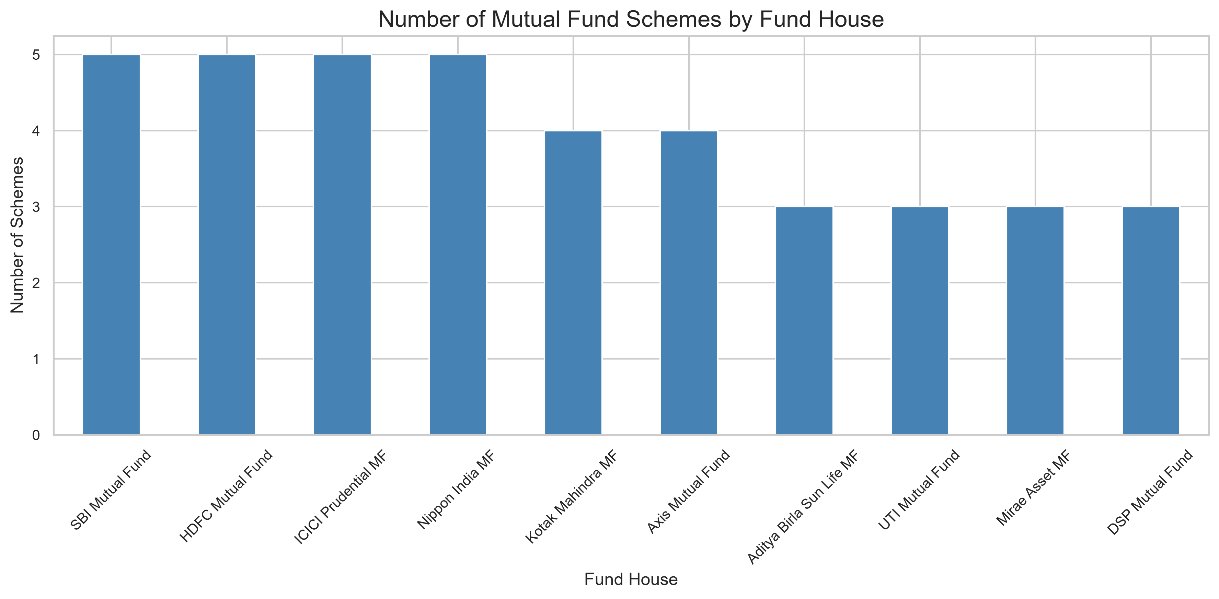
EDA Highlights — Market & Growth Trends
SECTION 04 · EXPLORATORY DATA ANALYSIS
15+ publication-quality charts profile NAV, AUM and SIP behaviour across 40 schemes.
Bluestock Fintech | Mutual Fund Analytics Platform
05

Slide 6
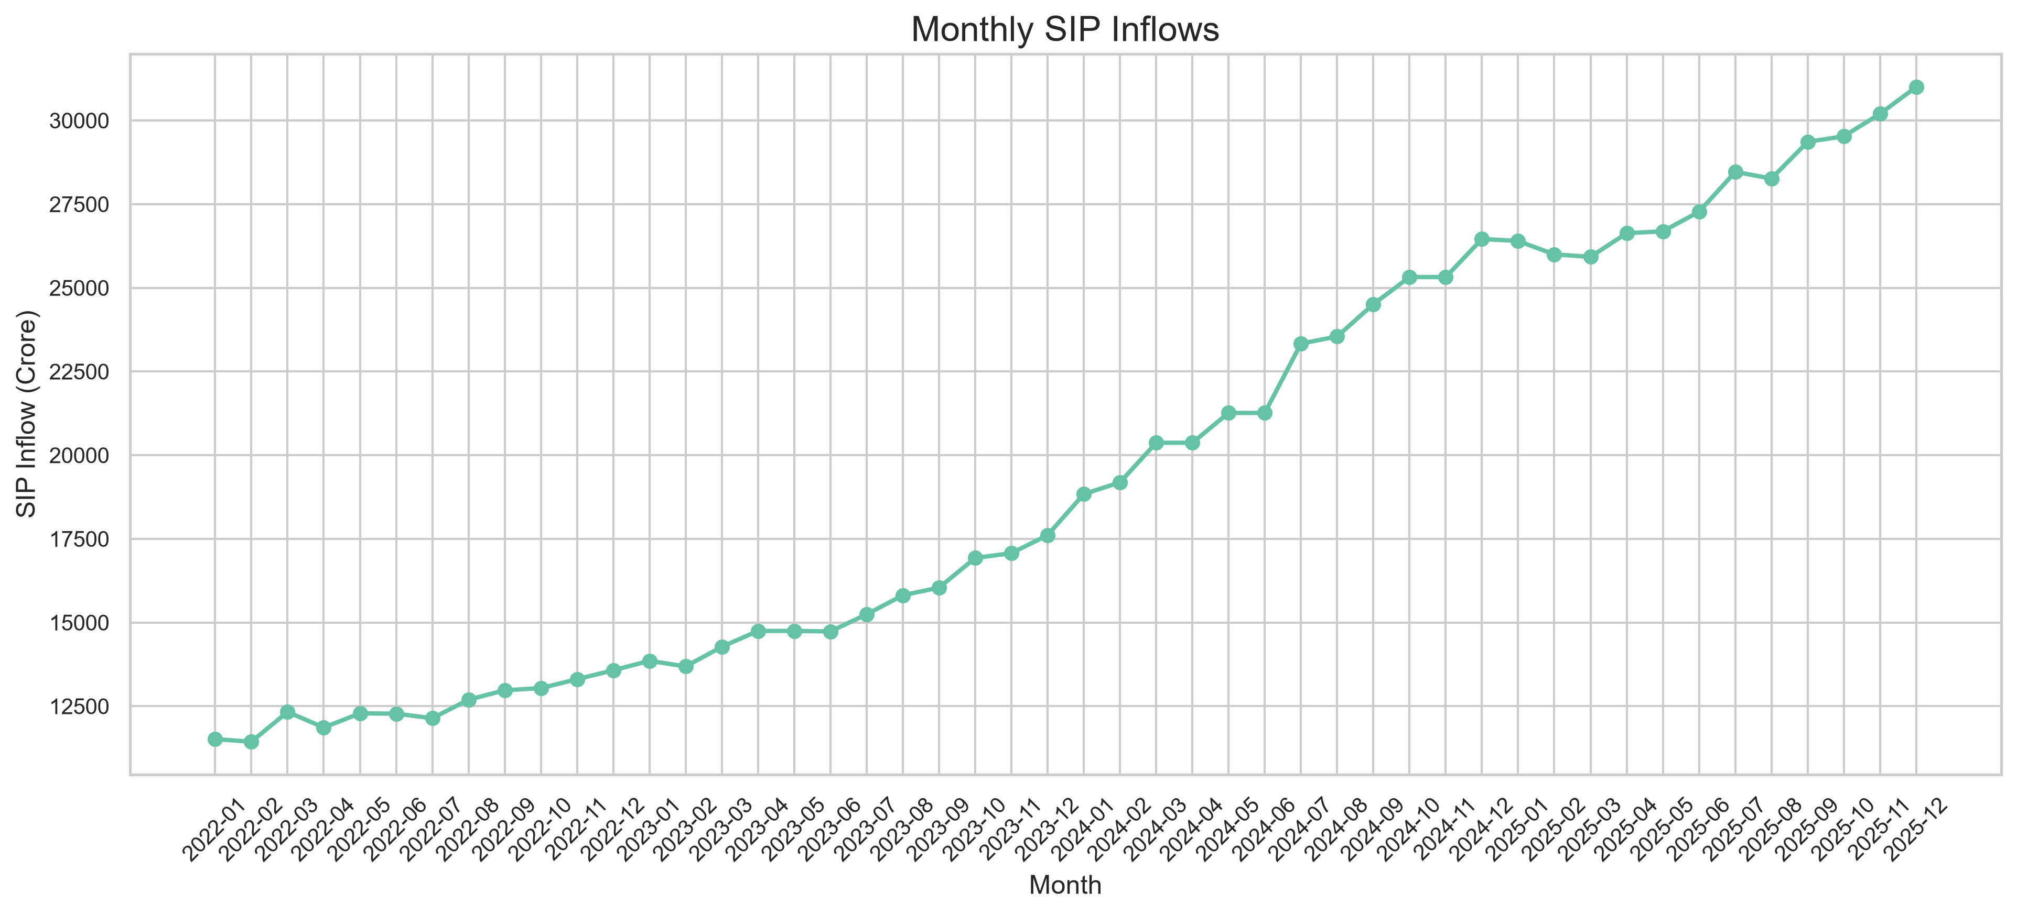
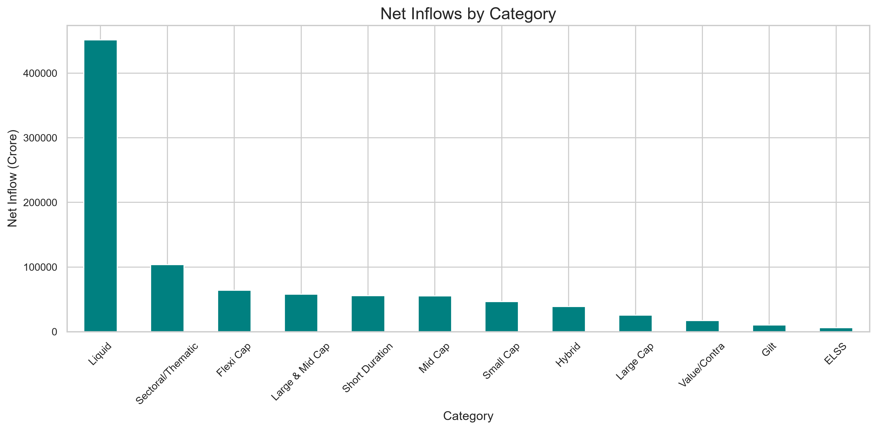
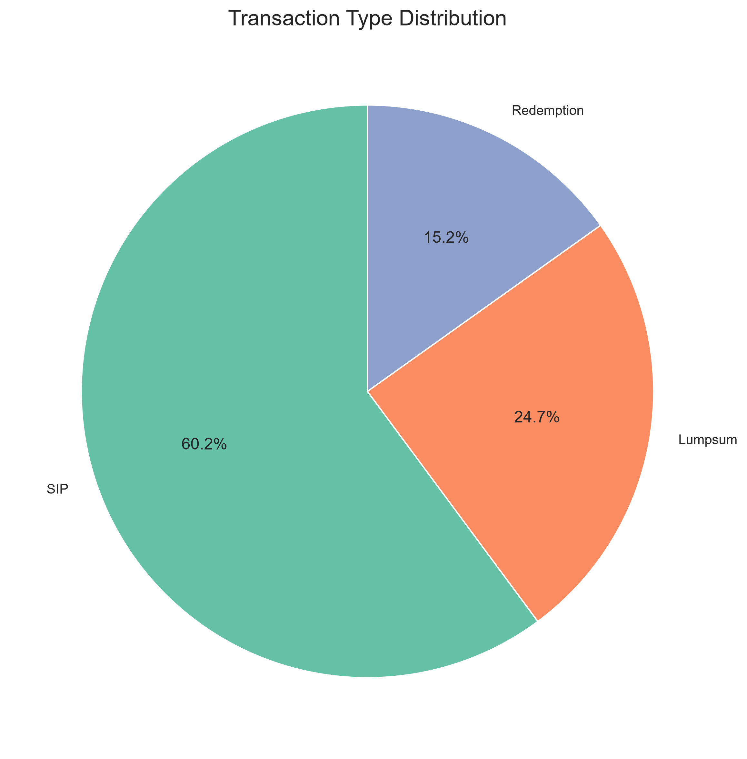
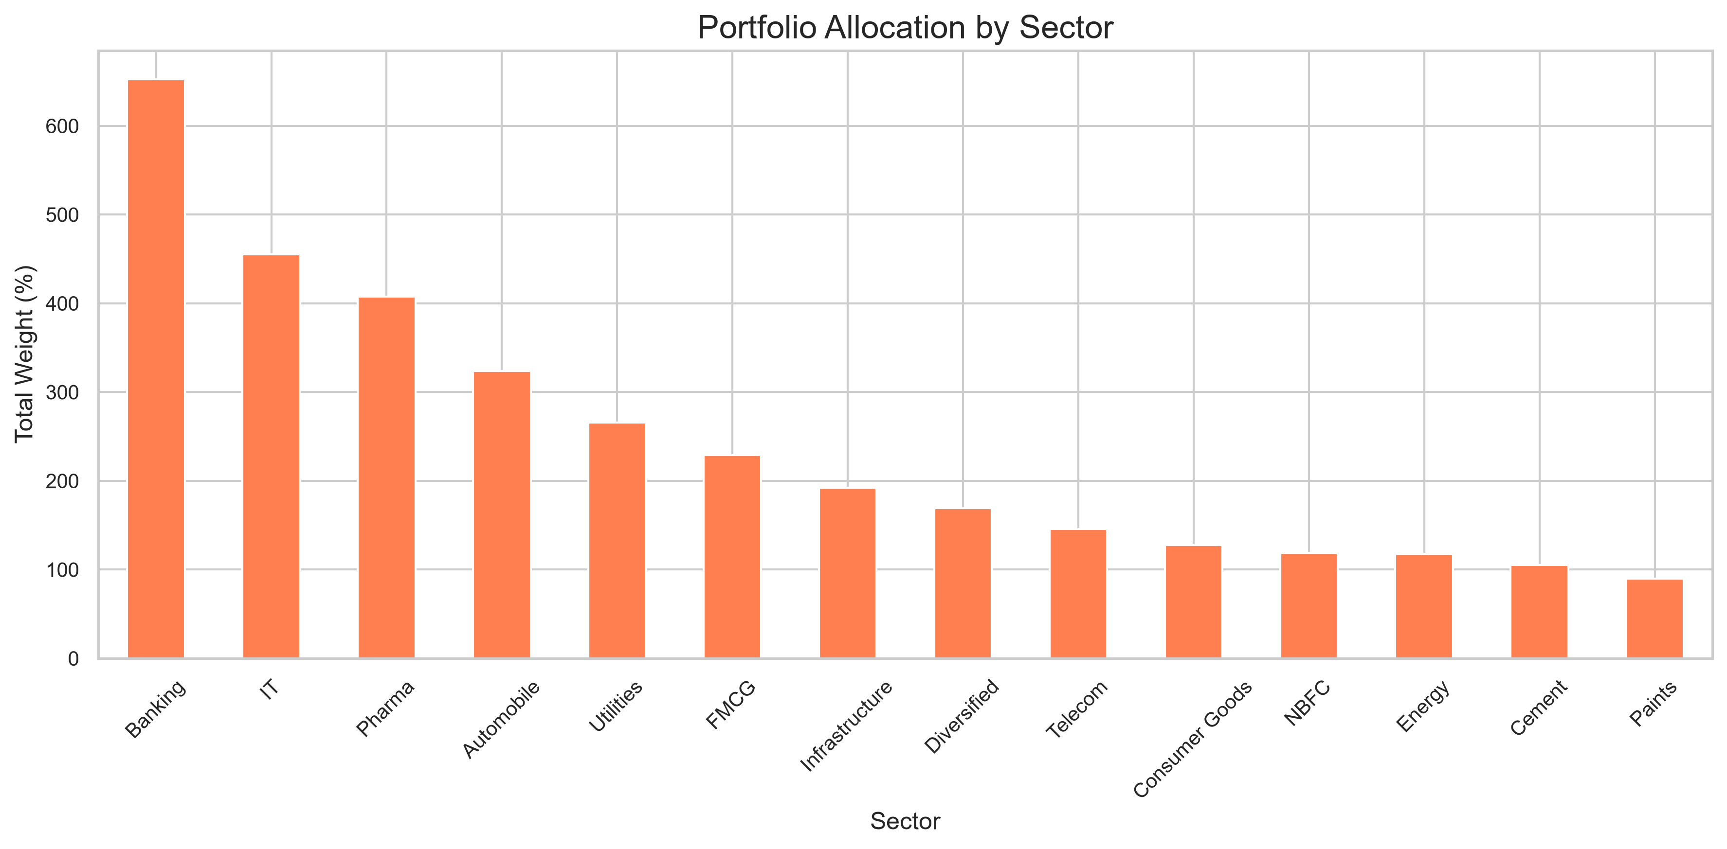
EDA Highlights — Flows & Investors
SECTION 04 · EXPLORATORY DATA ANALYSIS
Investor demographics, SIP flows and portfolio concentration at a glance.
Bluestock Fintech | Mutual Fund Analytics Platform
06

Slide 7
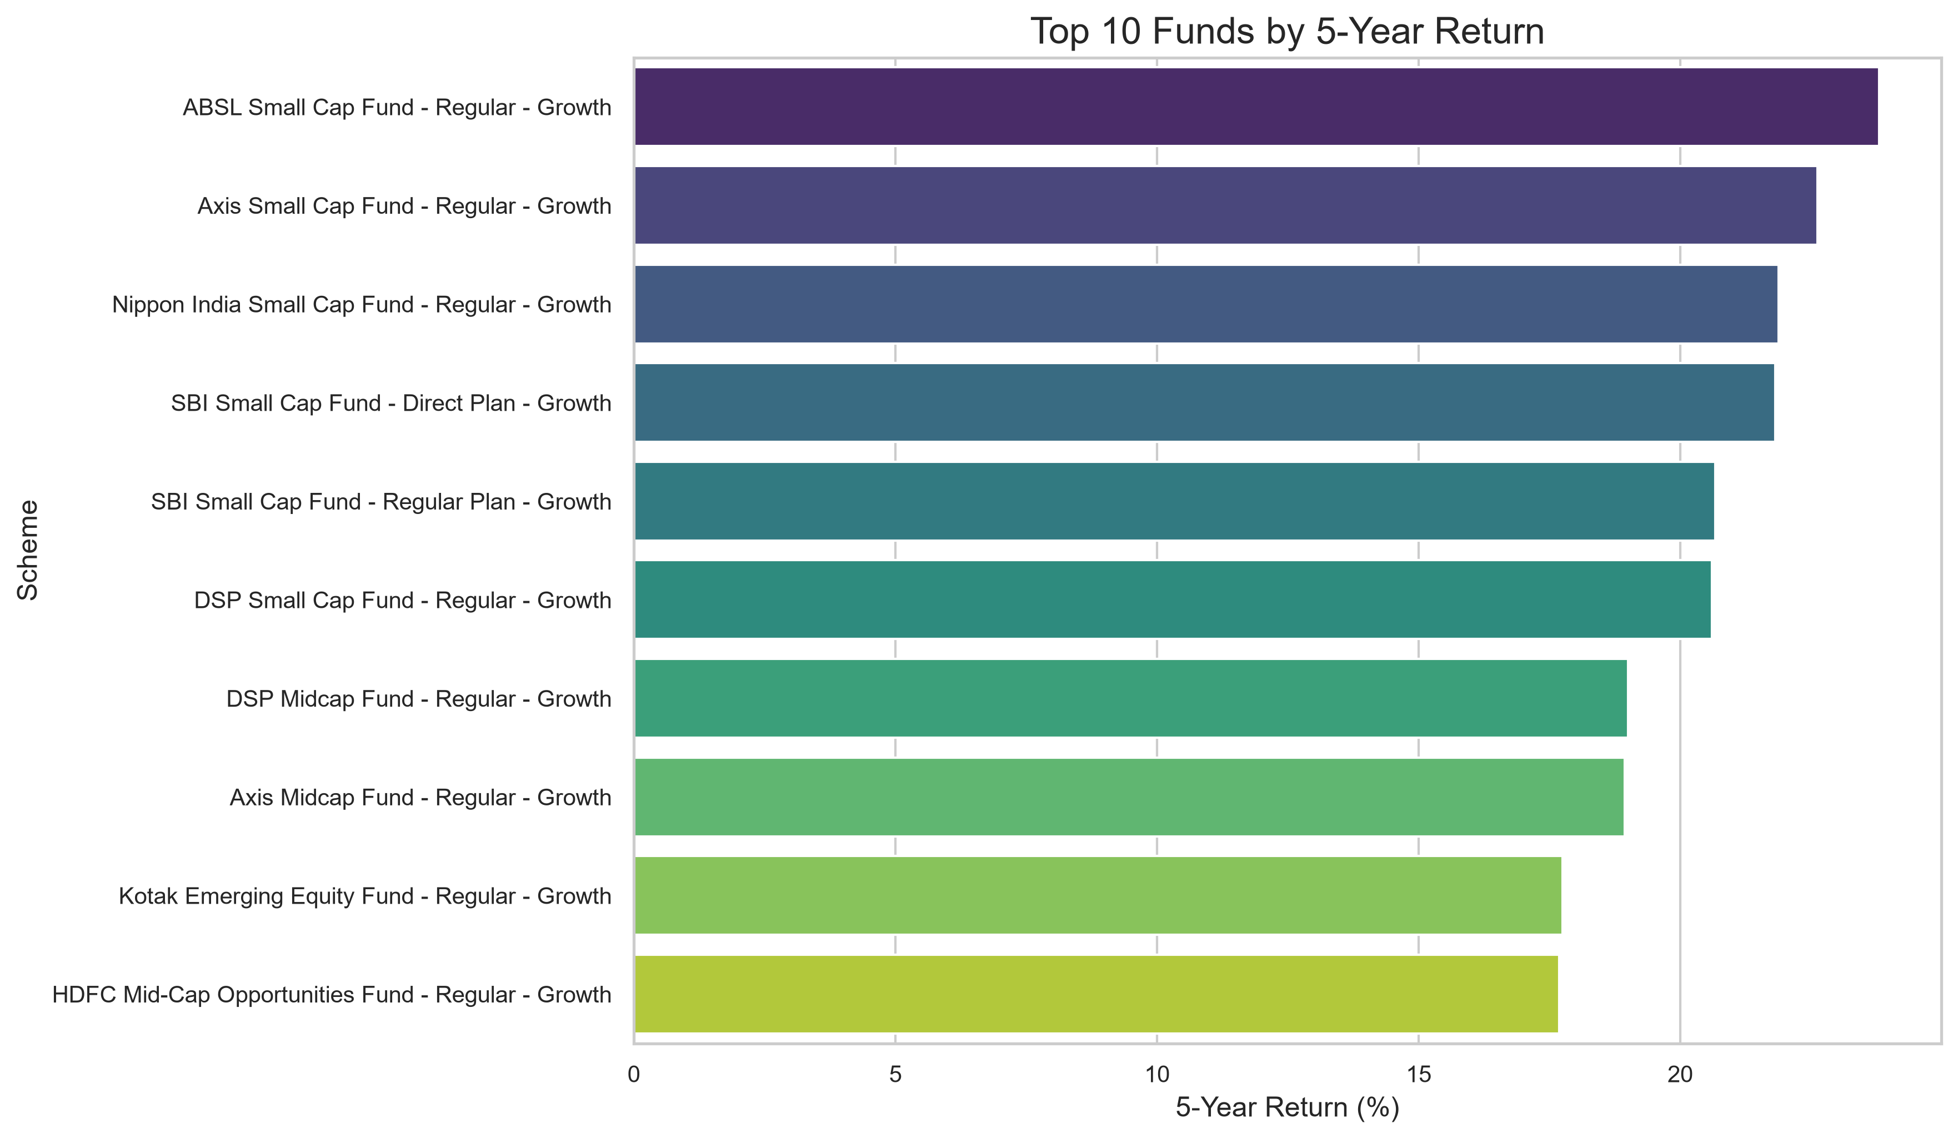
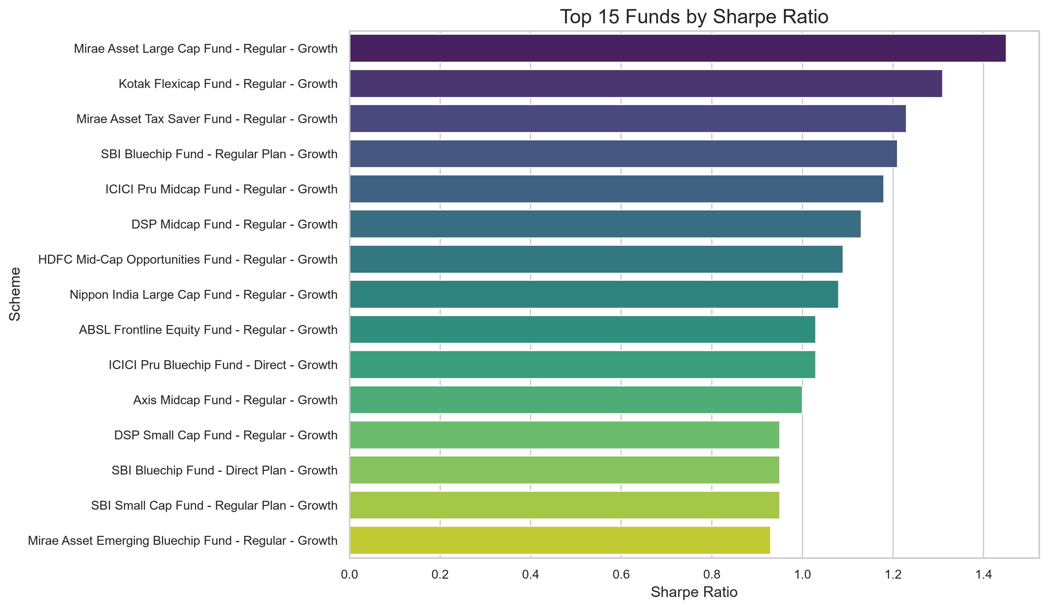
Performance & Risk Metrics
SECTION 05 · FUND PERFORMANCE ANALYTICS
Risk-adjusted metrics computed from NAV history for every scheme.
Sharpe
Sortino
Alpha / Beta
(Rp − Rf) / σ
(Rp − Rf) / σ↓
OLS vs Nifty 100
Max Drawdown
CAGR
Fund Score
min(NAV/peak − 1)
(end/start)^(1/n) − 1
weighted 0–100 rank
Bluestock Fintech | Mutual Fund Analytics Platform
07

Slide 8
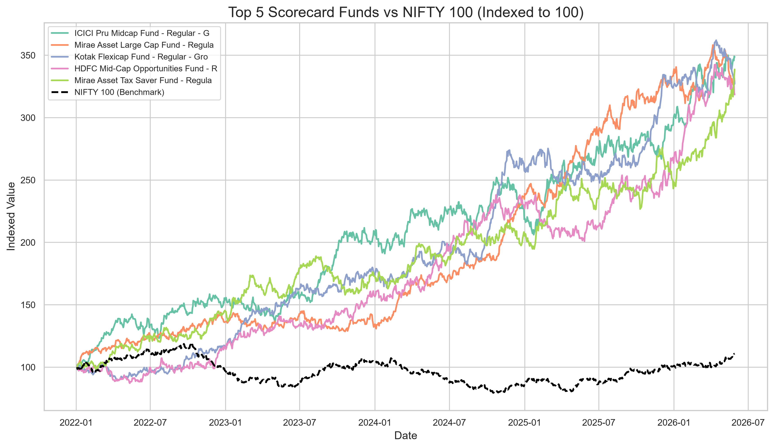
Benchmark Comparison & Rankings
SECTION 05 · FUND PERFORMANCE ANALYTICS
Fund returns benchmarked against Nifty 50 / Nifty 100 with rolling alpha and tracking error.
WHAT IT ANSWERS
Is the fund beating its benchmark?
Rolling 3-month alpha vs Nifty 100
Tracking error & information ratio
Best / worst performer per category
Composite fund scorecard ranking
Bluestock Fintech | Mutual Fund Analytics Platform
08

Slide 9
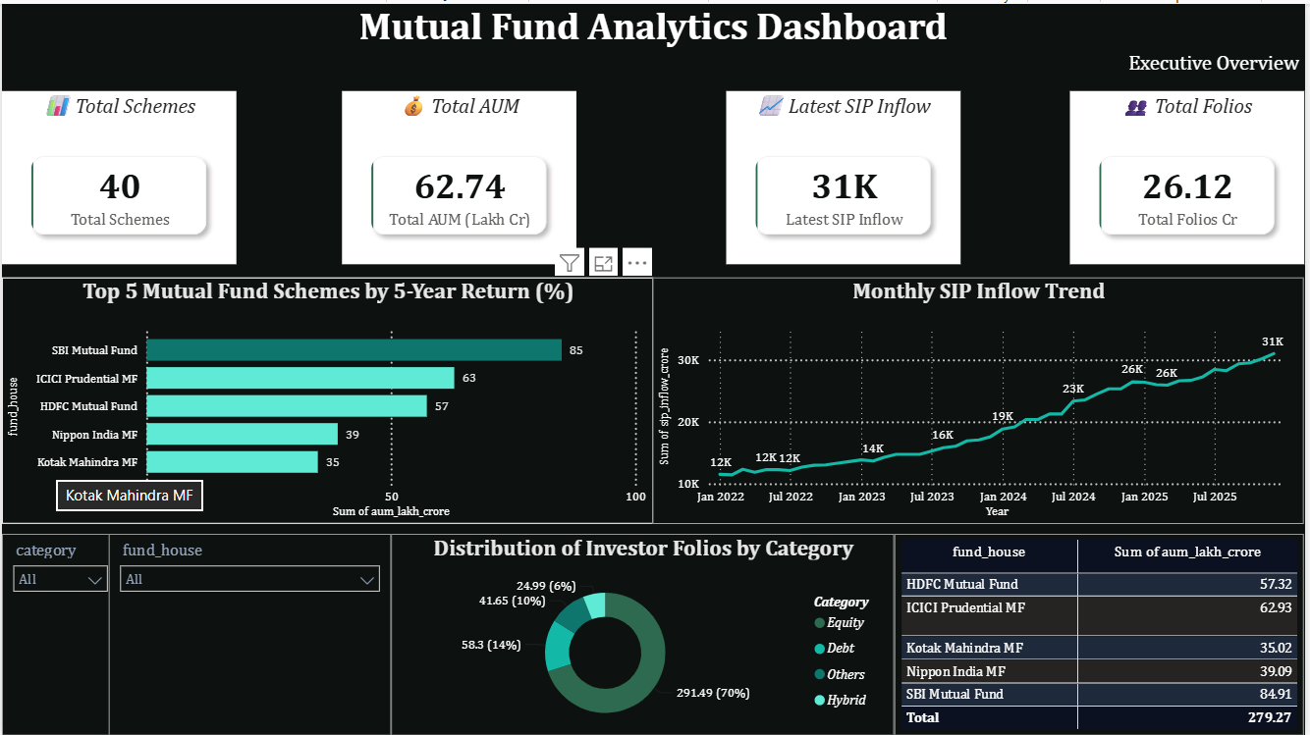
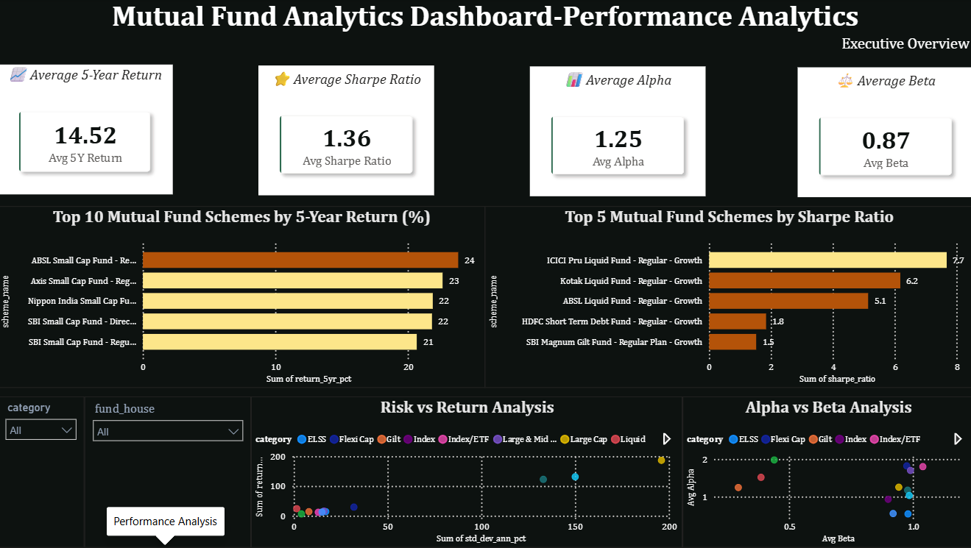
Power BI / Tableau Dashboard
SECTION 06 · INTERACTIVE DASHBOARD
Interactive Power BI report — KPI cards, slicers and drill-through across four pages.
Page 1 — Industry Overview
Schemes, AUM, SIP trend & folios by category
Page 2 — Fund Performance
5Y returns, Sharpe ranking, risk-return & alpha-beta
Bluestock Fintech | Mutual Fund Analytics Platform
09

Slide 10
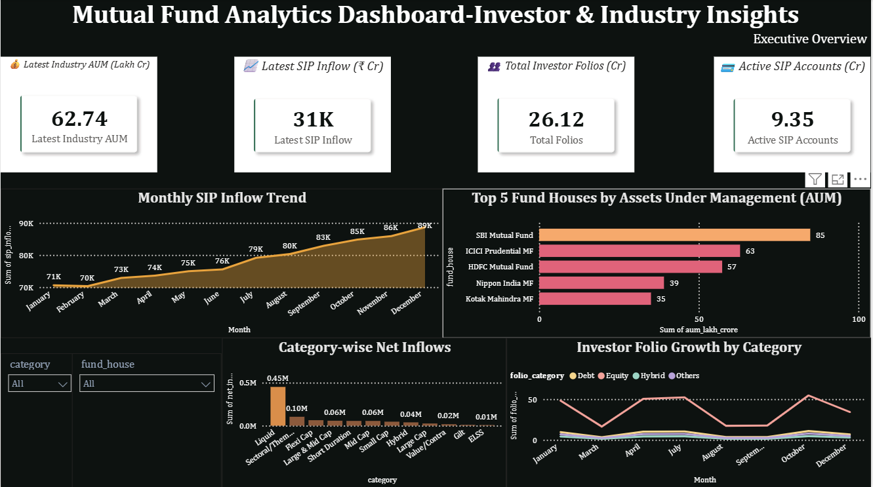
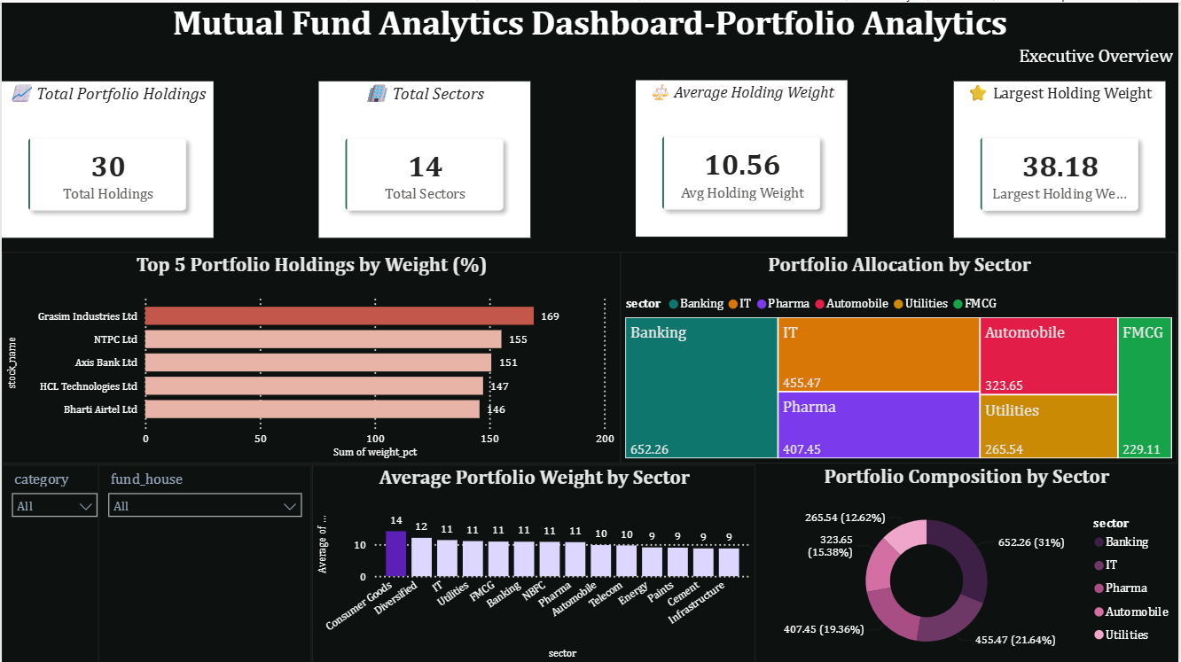
Investor & Portfolio Analytics
SECTION 06 · INTERACTIVE DASHBOARD
Two further report pages with slicers on state, age group, category and date.
Page 3 — Investor & Industry Insights
Transactions by state, SIP vs lumpsum & age-group split
Page 4 — Portfolio Analytics
SIP vs Nifty 50 trend, category heatmap & top holdings
Bluestock Fintech | Mutual Fund Analytics Platform
10

Slide 11
Key Findings & Insights
SECTION 07
Real AMFI data points anchoring the analysis (Dec 2025).
Rs.81 lakh cr
Rs.31,002 cr
26.12 cr
Industry AUM
Monthly SIP inflow
Investor folios
across 1,908 schemes — record scale
all-time high, deepening equity culture
up from 13.26 cr in Jan 2022
9.35 cr
Rs.12.5L cr
Sharpe · Alpha
Active SIP accounts
SBI MF — largest AMC
Risk-adjusted ranking
sustained retail participation
ahead of ICICI Pru & HDFC MF
funds scored 0–100 vs benchmark
Figures sourced from AMFI India / AMFI Monthly Notes; fund-level rankings computed in the project analytics.
Bluestock Fintech | Mutual Fund Analytics Platform
11

Slide 12

Thank You
BLUESTOCK FINTECH
Mutual Fund Analytics Platform — ETL, analytics & interactive BI, end to end.
DELIVERABLES: ETL pipeline · SQLite database · EDA notebook · performance metrics · BI dashboard · report + slides
GitHub: github.com/<your-repo> · Prepared by: Intern / Data Analyst — Bluestock Fintech · June 2026

